Slide 1
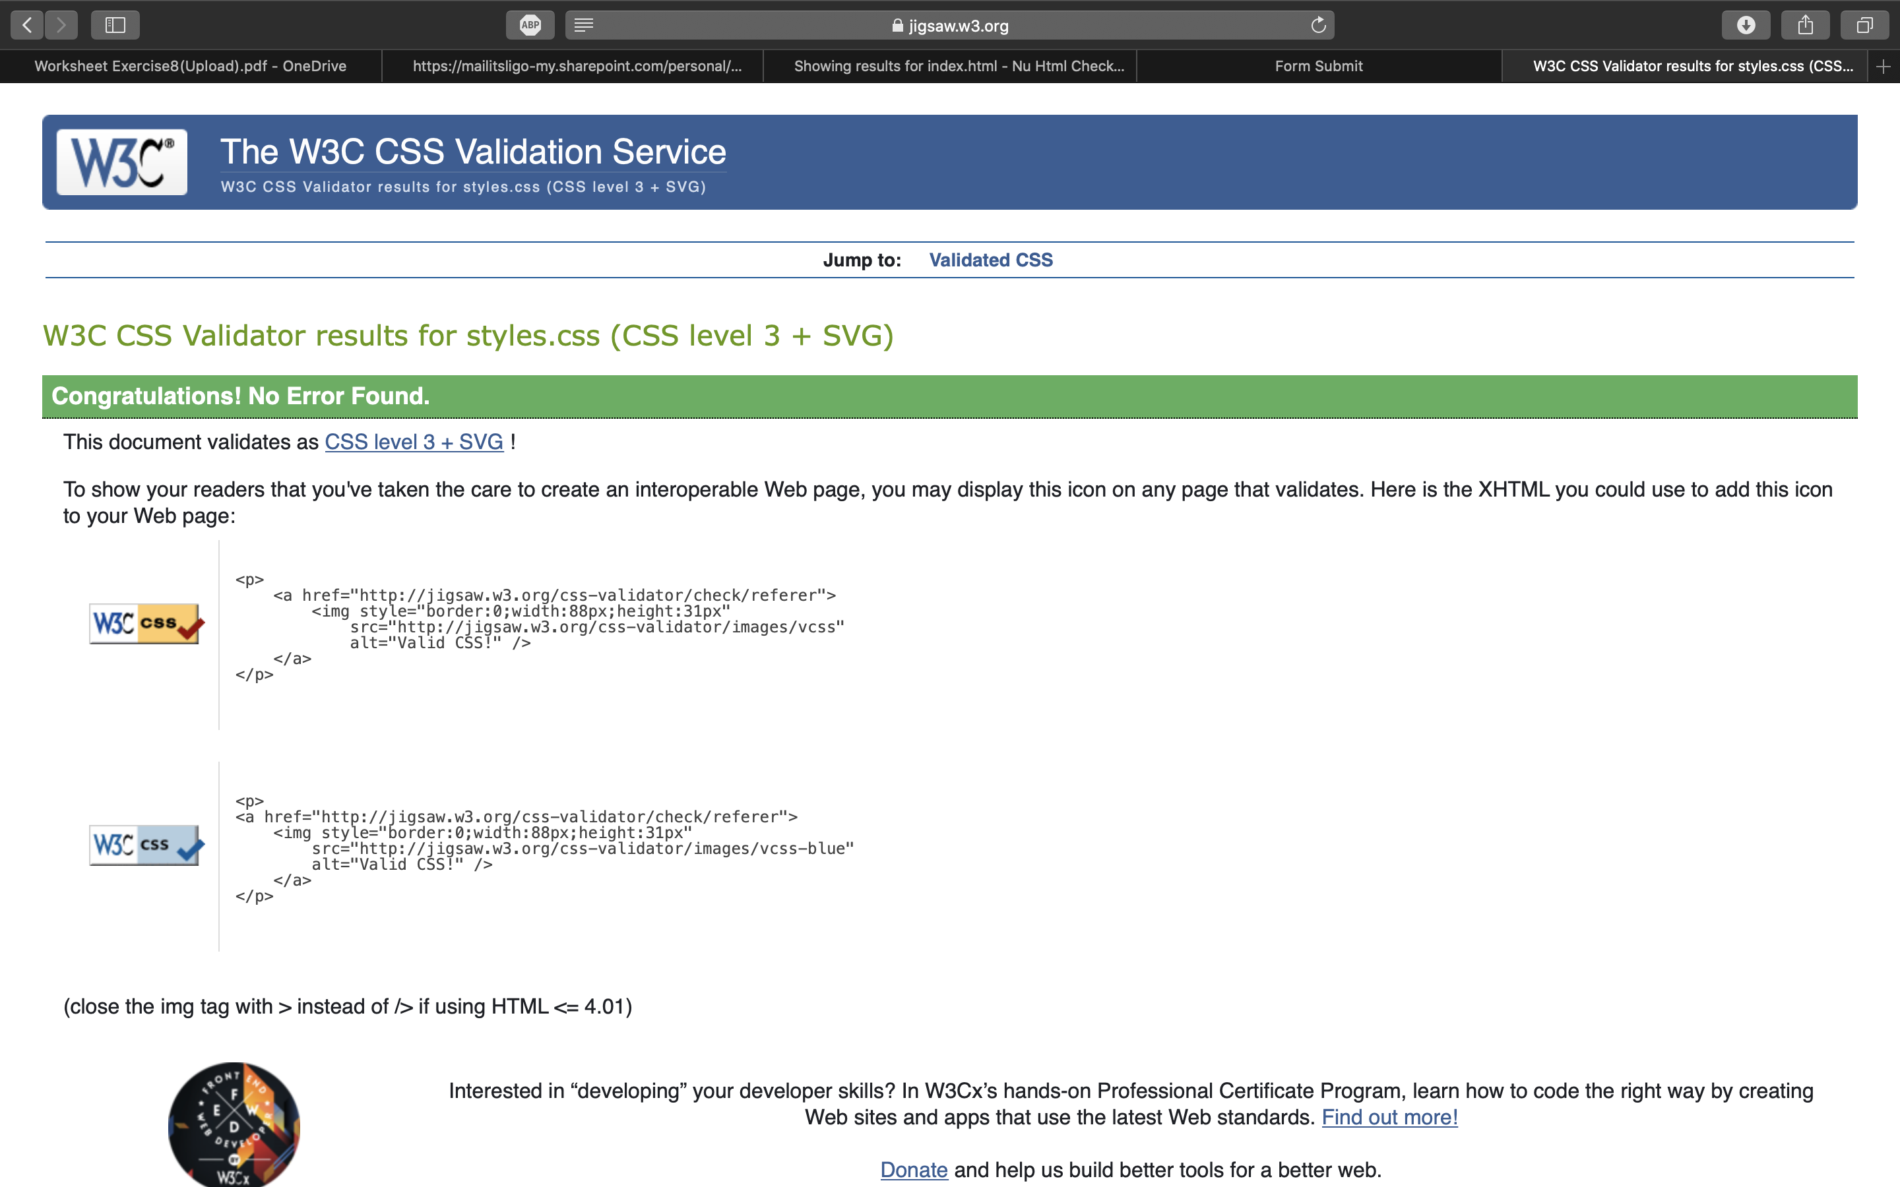

Slide 2
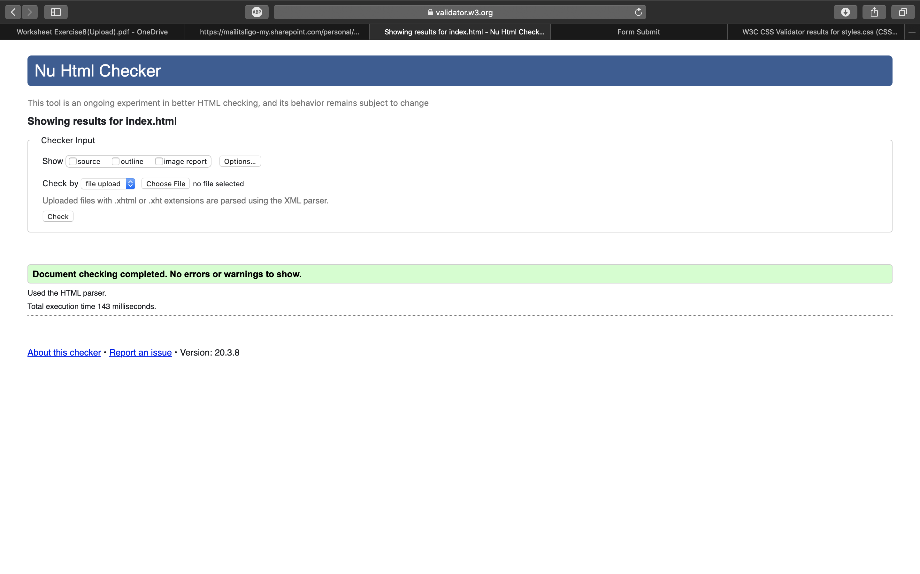

Slide 3
GitHub Pages URL
https://danielh55irl.github.io/Week-8-Exercise/

